Slide 1
SASS - advanced (Day 2)
Viktoras Lava www.viktoraslava.lt

Slide 2

Diving deep
We already talked about SASS, nesting, variables, import and partials.
Today we will talk about advanced features:
Mixins
Extend / Inheritance
Operators

Slide 3
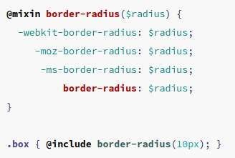
Mixins
Mixins let you to group your CSS declarations under one name.
You can create a mixin with a @mixin rule and you can call this mixin with the @include rule.

Slide 4
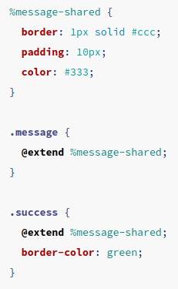
2. Extend / Inheritance
This is the most advanced function in SASS, it let’s you to share a set of CSS properties from one selector to another one.
You can define inheritance with % rule and you call it with the @extend rule.

Slide 5
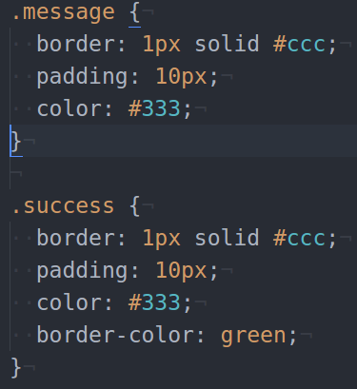
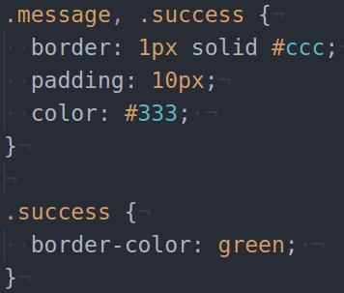
Mixins vs inheritance

Slide 6
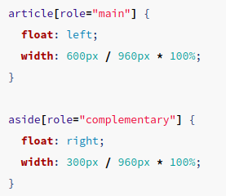
3. Operators
Operators let you to do math operations inside CSS.

Slide 7
Questions?

